Slide 1

Database Design
Entity-Relationship Modeling
N. Ilayaraja
PSG Tech.

Slide 2
Overview – Part 1
3.1 Introduction
3.2 The Entity-Relationship Model
3.3 Entity
3.4 Attributes
3.5 Relationships
3.6 Degree of a Relationship
3.7 Cardinality of a Relationship
3.8 Unary Relationship
3.9 Binary Relationship
3.10 Ternary Relationships
3.11 Attributes of Relationships
3.12 Associative Entities
3.13 Weak Entity Types

Slide 3
Overview – Part 2
3.14 Enhanced Entity-Relationship Modeling
3.15 Superclass, Subclass, and Relationships
3.16 Generalization and Specialization Process
3.17 Participation and Disjoint Constraints
3.18 Superclass/Subclass Hierarchy
3.19 Case Study: Conceptual Design for University Database
3.20 In-Class Assignment
3.21 Summary

Slide 4
Database Design Process
Database Design is a collection of processes that facilitate the designing, development, implementation and maintenance of enterprise data management systems.
Properly designed database are easy to maintain, improves data consistency and are cost effective in terms of disk storage space.
The database designer decides how the data elements correlate and what data must be stored.

Slide 5
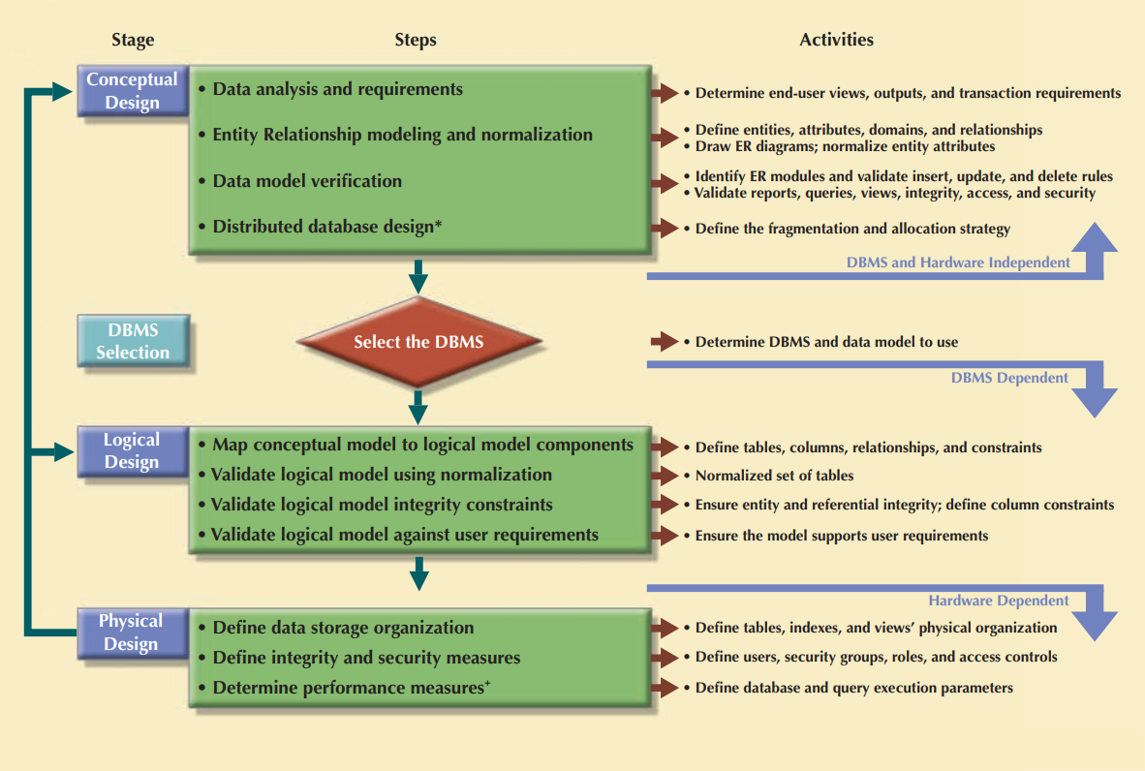
Database Design Process

Slide 6
Conceptual design:
is the process that designs a conceptual data model that describes the main data entities, attributes, relationships, and constraints of a given problem domain represents real-world objects in the most realistic way possible.
The process should follow a minimal data rule: All that needed is there, and all that is there is needed.

Slide 7
Introduction
A data model is an integrated collection of concepts that represents real world objects, events, and their relationships
  There are two types of data models:
    Object-based data models
    Relation-based data models
  In database design, we develop an object-based model first
    Entity-relationship model
    Functional model
    Object-oriented model
  Then systematically convert the model into a relation-based model
    More suitable for database implementation

Slide 8
Overview – Part 1
3.1 Introduction
3.2 The Entity-Relationship Model
3.3 Entity
3.4 Attributes
3.5 Relationships
3.6 Degree of a Relationship
3.7 Cardinality of a Relationship
3.8 Unary Relationship
3.9 Binary Relationship
3.10 Ternary Relationships
3.11 Attributes of Relationships
3.12 Associative Entities
3.13 Weak Entity Types

Slide 9
The Entity-Relationship Model
An entity-relationship model describes data in terms of the following:
  Entities
  Relationship between entities
  Attributes of entities
We graphically display an E-R model using an entity-relationship diagram (E-R diagram)
ER-diagrams are a formalism to model real-world scenarios
There are many versions of ER-diagrams that differ both in their appearance and in their meaning
ER-diagrams have a formal semantics (meaning) that must be thoroughly understood, in order to create correct diagrams

Slide 10
What is it about?
ER model is used to show the Conceptual schema of an organisation.
Independent of specific data model or DBMS
The model is later transformed into a Logical model (e.g. relational) on which the physical database is built
The most widely used form of Semantic modelling: attempt to capitalise on knowledge of meaning of data to inform the model.
So we need a vocabulary

Slide 11
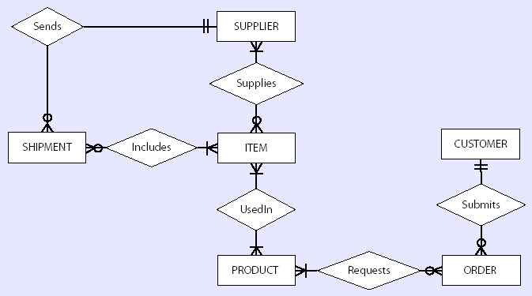
Entity-Relationship Diagram
Example of an E-R Diagram

Slide 12
Overview – Part 1
3.1 Introduction
3.2 The Entity-Relationship Model
3.3 Entity
3.4 Attributes
3.5 Relationships
3.6 Degree of a Relationship
3.7 Cardinality of a Relationship
3.8 Unary Relationship
3.9 Binary Relationship
3.10 Ternary Relationships
3.11 Attributes of Relationships
3.12 Associative Entities
3.13 Weak Entity Types

Slide 13
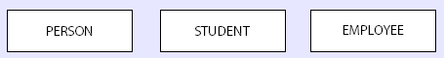
Entity
An entity is an object that exists in the world and which is distinguishable from other objects
  Can be a person, a place, an object, an event, or a concept
  Examples:
    Person: Student, Employee, Client
    Object: Couch, Airplane, Machine
    Place: City, Park, Room, Warehouse
    Event: War, Marriage, Lease
    Concept: Project, Account, Course
Entity Representation in an E-R Diagram

Slide 14
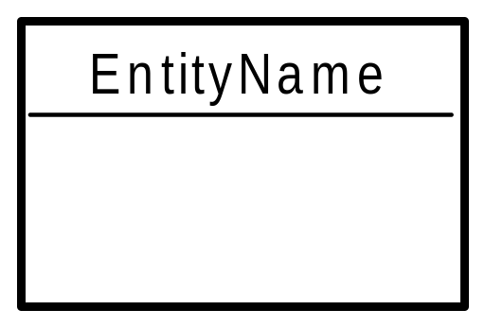
Entities
Entity - distinguishable “thing” in the real world
  Strong (or regular) entity - entities have an independent existence (e.g. staff)
  Weak entity - existence dependent on some other entity (e.g. next of kin)
Entity type name
(singular, no spaces,
capital letter at start of each word)
space for attributes

Slide 15
Entity (cont.)
An entity type defines a collection of entities that have the same attributes
An entity instance is a single item in this collection
An entity set is a set of entity instances which all are sharing the common properties/attributes ( not attributes values).
Example:
  Entity type: STUDENT
  Entity instance: Student with ID number 555-55-5555
  Entity set: Collection of all students

Slide 16
Overview – Part 1
3.1 Introduction
3.2 The Entity-Relationship Model
3.3 Entity
3.4 Attributes
3.5 Relationships
3.6 Degree of a Relationship
3.7 Cardinality of a Relationship
3.8 Unary Relationship
3.9 Binary Relationship
3.10 Ternary Relationships
3.11 Attributes of Relationships
3.12 Associative Entities
3.13 Weak Entity Types

Slide 17
Attributes
An attribute is a property or characteristic of an entity type
  We represent an entity with a set of attributes
  Used to describe entities
  Examples:
    STUDENT = {Student ID, SSN, Name, Address, Phone, Email, DOB}
    ORDER = {Order ID, Date of Order, Amount of Order}
    ACCOUNT = {Account Nr, Account type, Balance}
    CITY = {Name, State, Population}
  Attributes Types:
    Simple, composite, single-valued, multi-valued, stored, and derived

Slide 18
Attributes
Entity types have Attributes (or properties) which associate each entity with a value from a domain of values for that attribute
Attributes can be
  simple (atomic) e.g. Surname; date of birth
  composite e.g. address (street, town, postcode)
  multi-valued e.g. phone number
  complex nested multi-valued and composite
  base or derived e.g. D.O.B. ; age
  key
Relationship types can also have attributes! (see later)

Slide 19
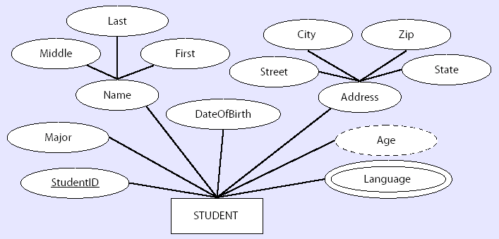
Attributes in E-R Diagram
Attributes of the STUDENT Entity Type

Slide 20
Attributes in E-R Diagram
ACTOR
birthday
id
name
address
Attributes of the ACTOR Entity Type

Slide 21
Another Option for a Key?
birthday
id
Actor
name
address

Slide 22
Simple and Composite Attributes
A simple or an atomic attribute cannot be further divided into smaller components
  Examples:
    City
    State
A composite attribute, however, can be divided into smaller subparts where each subpart represents an independent attribute
  Examples:
    Name: First Name, Last Name
    Address: Street, City, State, Zip

Slide 23
Single-Valued and Multi-Valued Attributes
Single-valued attributes have a single value for an entity instance
  Examples:
    Major
    Date Of Birth
Multi-valued attributes, on the other hand, may have more than one value for an entity instance
  Denoted with a double-lined ellipse
  Example:
    Languages: Stores the names of the languages that a student speaks

Slide 24
Stored and Derived Attributes
The value of a derived attribute can be determined by analyzing other attributes
  Therefore, no need to store them in the database directly
  Denoted with a dashed ellipse
  May be calculated and stored latter by using existing attributes or formula
  Example:
    Age: Can derived from the current date and the attribute DateOfBirth
An attribute whose value cannot be derived from the values of other attributes is called a stored attribute

Slide 25
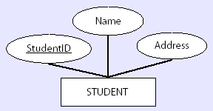
Key Attribute
A key attribute (or identifier) is a single attribute or a combination of attributes that uniquely identify an individual instance of an entity type
  Underlined in an E-R diagram
  Example:
    Student: StudentID
The Key Attribute

Slide 26
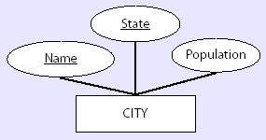
Candidate Key Attribute
Sometimes no single attribute can uniquely identify an instance of an entity type
A composite key is a composite attribute that uniquely identifies each entity instance
  Example:
    City: {Name, State}
The Composite Key Attribute

Slide 27
Overview – Part 1
3.1 Introduction
3.2 The Entity-Relationship Model
3.3 Entity
3.4 Attributes
3.5 Relationships
3.6 Degree of a Relationship
3.7 Cardinality of a Relationship
3.8 Unary Relationship
3.9 Binary Relationship
3.10 Ternary Relationships
3.11 Attributes of Relationships
3.12 Associative Entities
3.13 Weak Entity Types

Slide 28
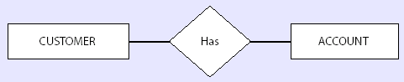
Relationships
A relationship is an association / binding / links / bonds among several entities ( entity types)
Examples:
  STUDENT “takes” COURSES
  CUSTOMER “has” ACCOUNT
  CUSTOMER “books” TICKET
  FACULTY “assign to “ CABIN
Represented by diamond shaped box connected to relating entities
Relationship between CUSTOMER and ACCOUNT Entities
Relationship Set: Set of similar relationships

Slide 29
Overview – Part 1
3.1 Introduction
3.2 The Entity-Relationship Model
3.3 Entity
3.4 Attributes
3.5 Relationships
3.6 Degree of a Relationship
3.7 Cardinality of a Relationship
3.8 Unary Relationship
3.9 Binary Relationship
3.10 Ternary Relationships
3.11 Attributes of Relationships
3.12 Associative Entities
3.13 Weak Entity Types

Slide 30
Degree of a Relationship
The number of entity sets that participate in a relationship is called the degree of relationship
Three common degrees in a database:
  Unary (degree 1)
    An association between two instances of the same entity type
    R є E1 x E1
  Binary (degree 2)
    An association between two instances of two different types
    R є E1 x E2
  Ternary (degree 3)
    An association between three instances of three different types
    R є E1 x E2 x E3

Slide 31
Overview – Part 1
3.1 Introduction
3.2 The Entity-Relationship Model
3.3 Entity
3.4 Attributes
3.5 Relationships
3.6 Degree of a Relationship
3.7 Cardinality of a Relationship
3.8 Unary Relationship
3.9 Binary Relationship
3.10 Ternary Relationships
3.11 Attributes of Relationships
3.12 Associative Entities
3.13 Weak Entity Types

Slide 32
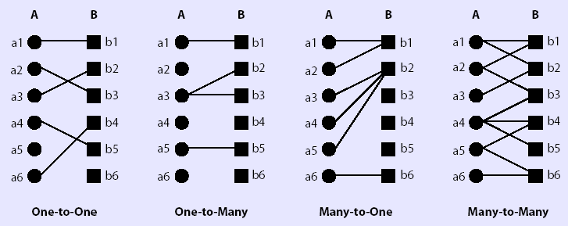
Cardinality of a Relationship
Maximum cardinality represents the maximum number of instances of entity B that can be associated with any instance of entity A
The Four Types of Relationships between Entity Types

Slide 33
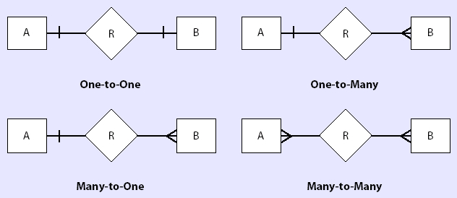
Maximum Cardinality
Relationship types by maximum cardinality:
  One-to-One
  One-to-Many (and vice-versa)
  Many-to-Many
One
Many
Relationship Types Based on Maximum Cardinality

Slide 34
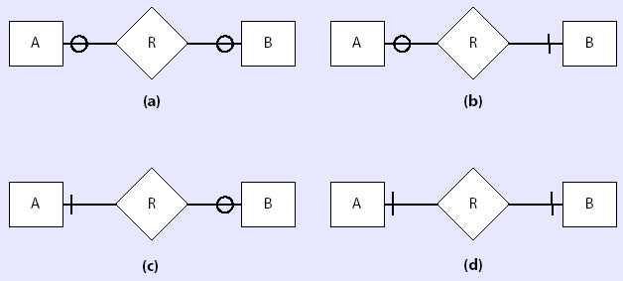
Minimum Cardinality
The minimum cardinality of a relationship is defined as the minimum number of instances of entity B that must be associated with each instance of entity A
Optional
Mandatory
Relationship Types Based on Minimum Cardinality

Slide 35
Overview – Part 1
3.1 Introduction
3.2 The Entity-Relationship Model
3.3 Entity
3.4 Attributes
3.5 Relationships
3.6 Degree of a Relationship
3.7 Cardinality of a Relationship
3.8 Unary Relationship
3.9 Binary Relationship
3.10 Ternary Relationships
3.11 Attributes of Relationships
3.12 Associative Entities
3.13 Weak Entity Types

Slide 36
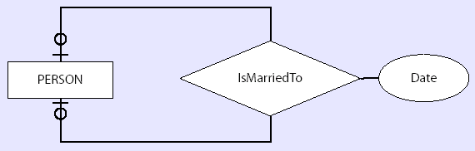
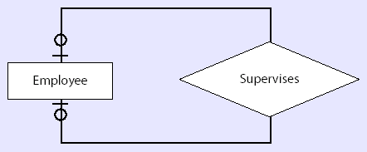
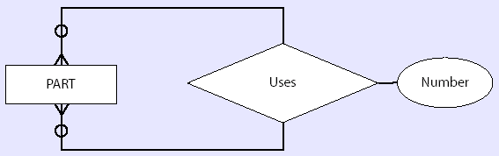
Unary Relationships - Examples
One-to-One
One-to-One
Many-to-Many

Slide 37
Recursive Unary Relationships
An entity set can participate more than once in a relationship
In this case, we add a description of the role to the ER-diagram
phone number
manager
id
Employee
Manages
worker
name
address

Slide 38
Overview – Part 1
3.1 Introduction
3.2 The Entity-Relationship Model
3.3 Entity
3.4 Attributes
3.5 Relationships
3.6 Degree of a Relationship
3.7 Cardinality of a Relationship
3.8 Unary Relationship
3.9 Binary Relationship
3.10 Ternary Relationships
3.11 Attributes of Relationships
3.12 Associative Entities
3.13 Weak Entity Types

Slide 39
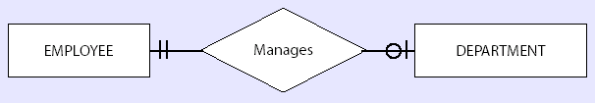
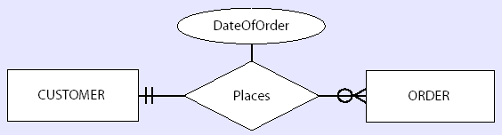
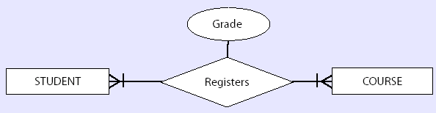
Binary Relationships - Examples
One-to-One
One-to-Many
Many-to-Many

Slide 40
Example
title
birthday
id
Actor
Acted In
Film
year
name
address
type
Where does the salary attribute belong?
salary

Slide 41
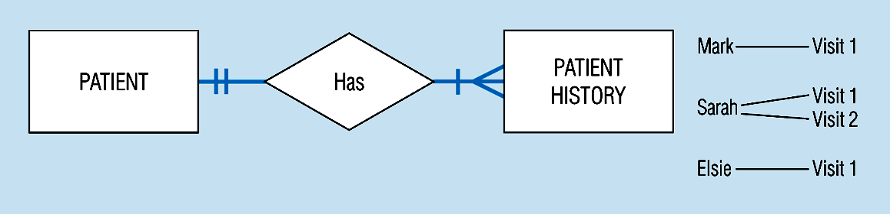
Mandatory minimum cardinalities

Slide 42
Overview – Part 1
3.1 Introduction
3.2 The Entity-Relationship Model
3.3 Entity
3.4 Attributes
3.5 Relationships
3.6 Degree of a Relationship
3.7 Cardinality of a Relationship
3.8 Unary Relationship
3.9 Binary Relationship
3.10 Ternary Relationships
3.11 Attributes of Relationships
3.12 Associative Entities
3.13 Weak Entity Types

Slide 43
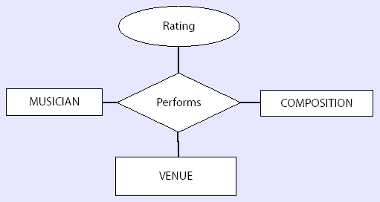
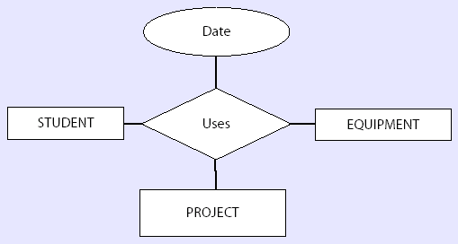
Ternary Relationships - Examples
Musical Performance
Example
Student “Uses”
Equipment for a
Project Example

Slide 44
Ternary Relationships - Examples
Director
id
name
id
Actor
Produced
Film
title
name

Slide 45
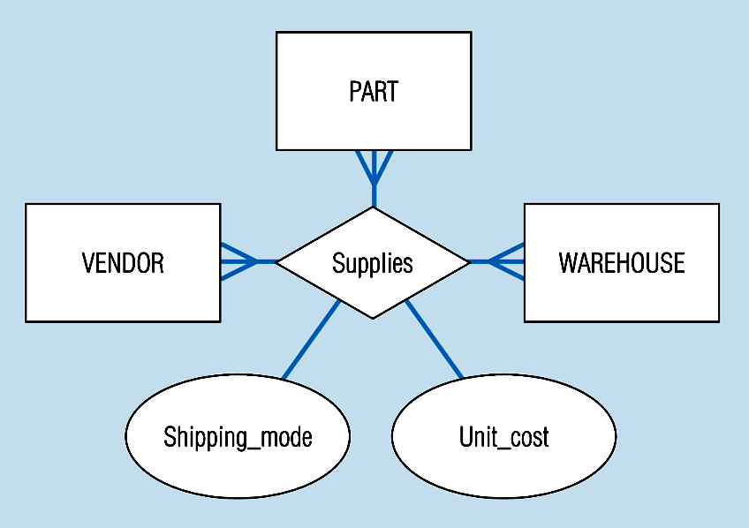
Ternary relationships
Note: a relationship can have attributes of its own
Notes:
24

Slide 46
Key Constraints
Key constraints specify whether an entity can participate in one, or more than one, relationships in a relationship set
When there is no key constraint an entity can participate any number of times
When there is a key constraint, the entity can participate at most one time
 Key constraints are drawn using an arrow from the entity set to the relationship set

Slide 47
One-to-Many
A film is directed by at most one director
A director can direct any number of films
id
Director
Directed
Film
title
name
Director
Directed
Film

Slide 48
Many-to-Many
A film is directed by any number of directors
A director can direct any number of films
id
Director
Directed
Film
title
name
Director
Directed
Film

Slide 49
One-to-One
A film is directed by at most one director
A director can direct at most one film
id
Director
Directed
Film
title
name
Director
Directed
Film

Slide 50
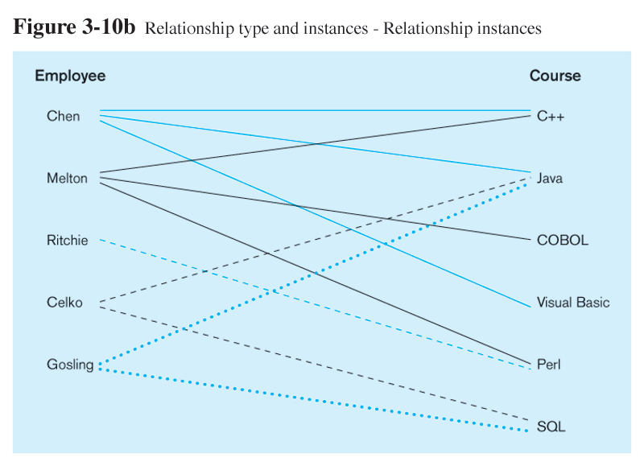
Relationship Instance is between specific entity instances

Slide 51

Relationship Sets
An attribute can also be property of a relationship set.

Slide 52
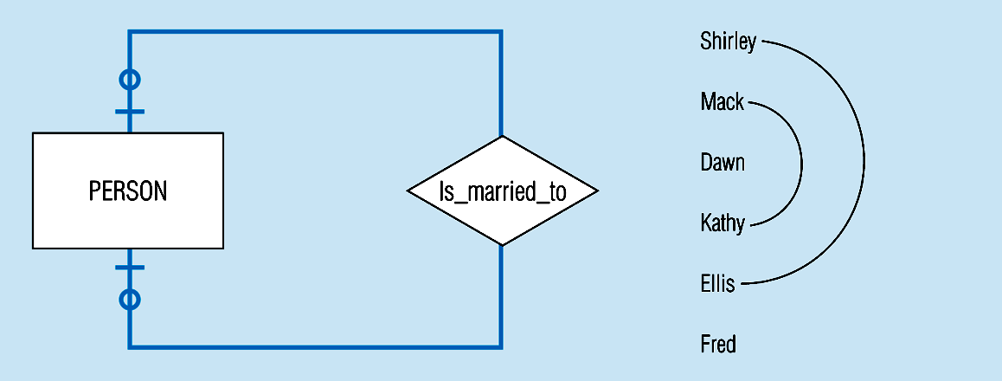
Optional cardinalities with unary degree, one-to-one relationship
Notes:
34

Slide 53
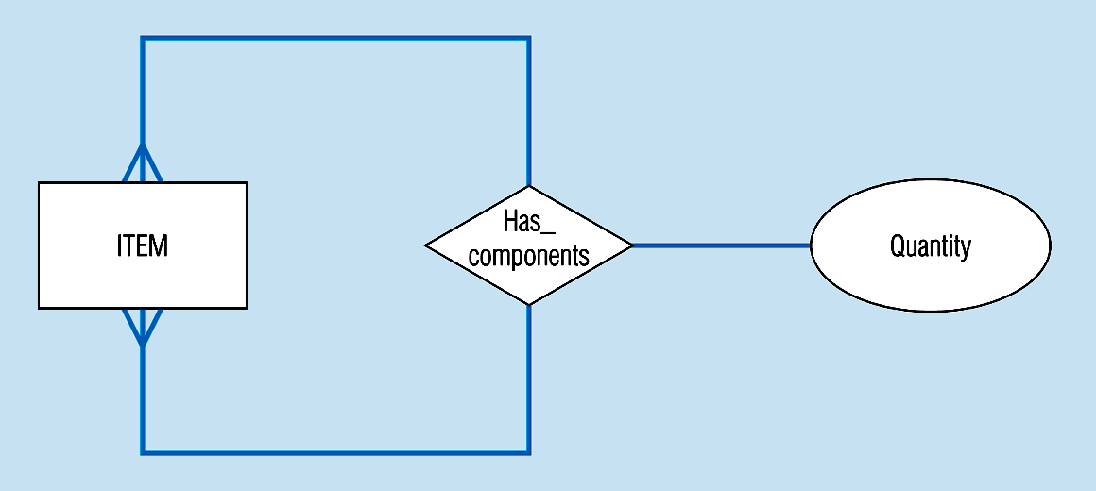
A unary relationship with an attribute. This has a many-to-many relationship
Representing a bill-of -materials structure
Notes:
25

Slide 54
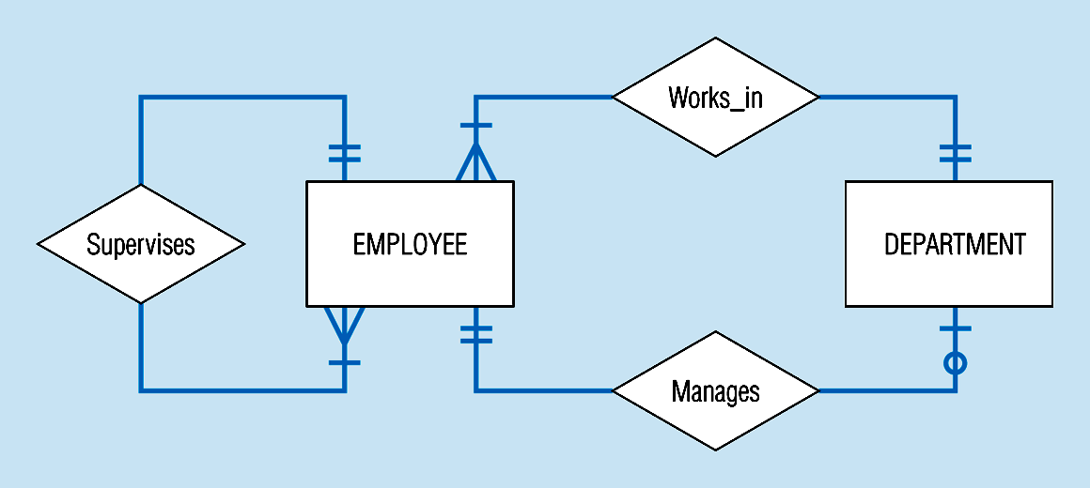
Examples of multiple relationships – entities can be related to one another in more than one way
Notes:
40

Slide 55
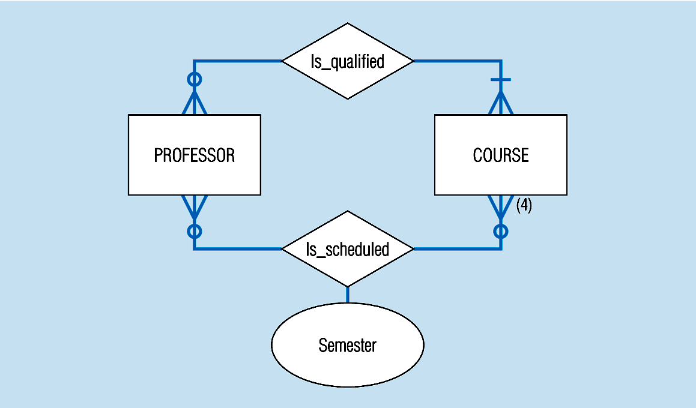
Professors and courses (fixed upon constraint)
Here,max cardinality constraint is 4
Notes:
41

Slide 56
Overview – Part 1
3.1 Introduction
3.2 The Entity-Relationship Model
3.3 Entity
3.4 Attributes
3.5 Relationships
3.6 Degree of a Relationship
3.7 Cardinality of a Relationship
3.8 Unary Relationship
3.9 Binary Relationship
3.10 Ternary Relationships
3.11 Attributes of Relationships
3.12 Associative Entities
3.13 Weak Entity Types

Slide 57
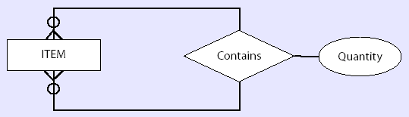
Attributes of Relationships
An attribute on a relationship stores information related to the relationship is known as “Descriptive Attribute”
  Much like attributes on entity types
Relationship
Attribute
Example of an Attribute of a Relationship

Slide 58
Overview – Part 1
3.1 Introduction
3.2 The Entity-Relationship Model
3.3 Entity
3.4 Attributes
3.5 Relationships
3.6 Degree of a Relationship
3.7 Cardinality of a Relationship
3.8 Unary Relationship
3.9 Binary Relationship
3.10 Ternary Relationships
3.11 Attributes of Relationships
3.12 Associative Entities
3.13 Weak Entity Types

Slide 59
Associative Entities
An entity–has attributes
A relationship–links entities together
When should a relationship with attributes instead be an associative entity?
  All relationships for the associative entity should be many
  The associative entity could have meaning independent of the other entities
  The associative entity preferably has a unique identifier, and should also have other attributes
  The associative entity may participate in other relationships other than the entities of the associated relationship
  Ternary relationships should be converted to associative entities

Slide 60
Associative Entities
An associative entity is an entity type that connects the instances of one or more entity types and contains attributes particular to this association
  Allows us to store data from relationship attributes more effectively
Relationship meets one of the following conditions:
  It is a many-to-many binary relationship
  It is a ternary relationship or a relationship of an even higher degree

Slide 61
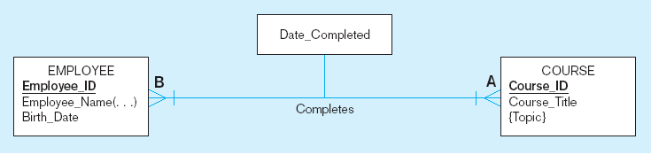
A binary relationship with an attribute
Here, the date completed attribute pertains specifically to the employee’s completion of a course…it is an attribute of the relationship
Notes:
20

Slide 62
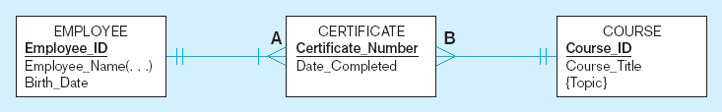
An associative entity (CERTIFICATE)
Associative entity is like a relationship with an attribute, but it is also considered to be an entity in its own right.
Note that the many-to-many cardinality between entities in above has been replaced by two one-to-many relationships with the associative entity.
Notes:
21

Slide 63
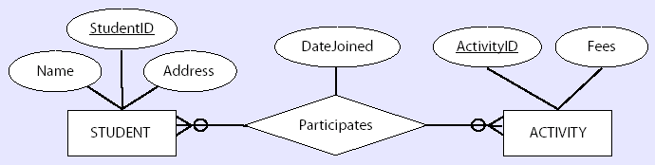
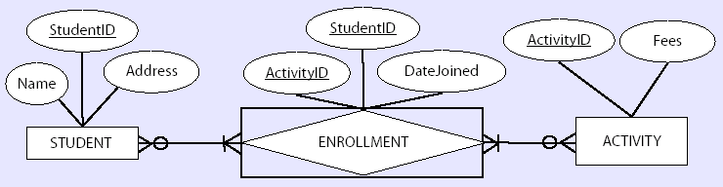
Associative Entities – Example 1
Many-to-Many Binary Relationship
Many-to-Many Binary Relationship Converted to an Associated Entity

Slide 64
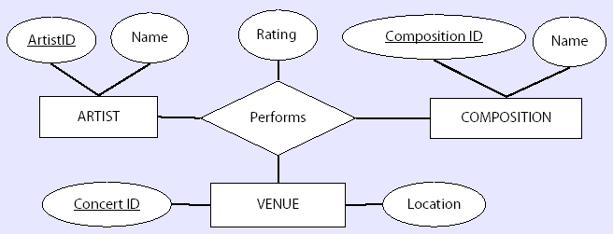
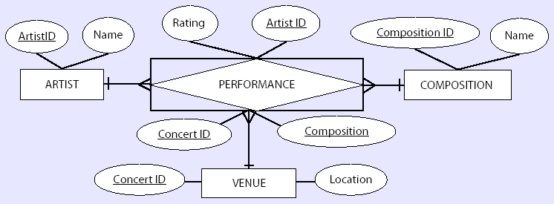
Associative Entities – Example 2
Ternary Relationship
Ternary Relationship Converted to an Associated Entity

Slide 65
Overview – Part 1
3.1 Introduction
3.2 The Entity-Relationship Model
3.3 Entity
3.4 Attributes
3.5 Relationships
3.6 Degree of a Relationship
3.7 Cardinality of a Relationship
3.8 Unary Relationship
3.9 Binary Relationship
3.10 Ternary Relationships
3.11 Attributes of Relationships
3.12 Associative Entities
3.13 Weak Entity Types

Slide 66
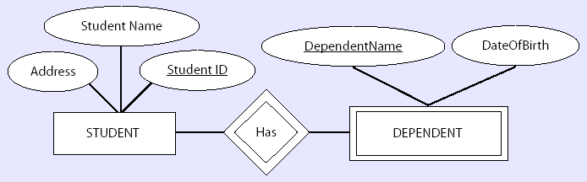
Weak Entity Types
A strong entity type exists independent of other entity types
A weak entity type depends on another entity type
Entity type depends on the identifying owner
Weak
Entity
Weak Entity in an E-R Diagram

Slide 67
Strong vs. Weak Entities, and
Identifying Relationships
Strong entities:
  exist independently of other types of entities
  has its own unique identifier
  identifier underlined with single-line
Weak entity:
  dependent on a strong entity (identifying owner)…cannot exist on its own
  does not have a unique identifier (only a partial identifier)
  Partial identifier underlined with double-line
  Entity box has double line
Identifying relationship:
  links strong entities to weak entities

Slide 68
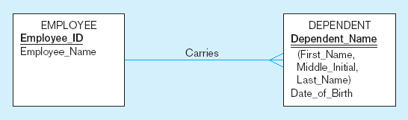
Identifying relationship
Strong entity
Weak entity

Slide 69
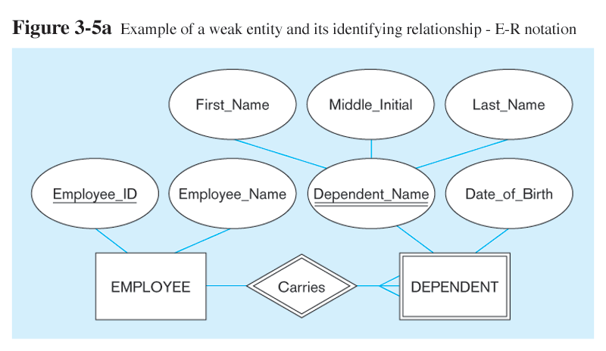
Strong entity
Identifying relationship
Weak entity

Slide 70
Existence Dependencies
If the existence of entity x depends on the existence of entity y, then x is said to be existence dependent on y.
  y is a dominant entity (in example below, loan)
  x is a subordinate entity (in example below, payment)
loan-payment
loan
payment
If a loan entity is deleted, then all its associated payment entities must be deleted also.

Slide 71
Weak Entity Primary Key
The discriminator (or partial key) of a weak entity set is the set of attributes that distinguishes among all the entities of a weak entity set.
The primary key of a weak entity set is formed by the primary key of the strong entity set on which the weak entity set is existence dependent, plus the weak entity set’s discriminator.

Slide 72

Weak Entity Sets
We depict a weak entity set by double rectangles.
We underline the discriminator of a weak entity set with a dashed line.
payment-number – discriminator of the payment entity set
Primary key for payment – (loan-number, payment-number)

Slide 73
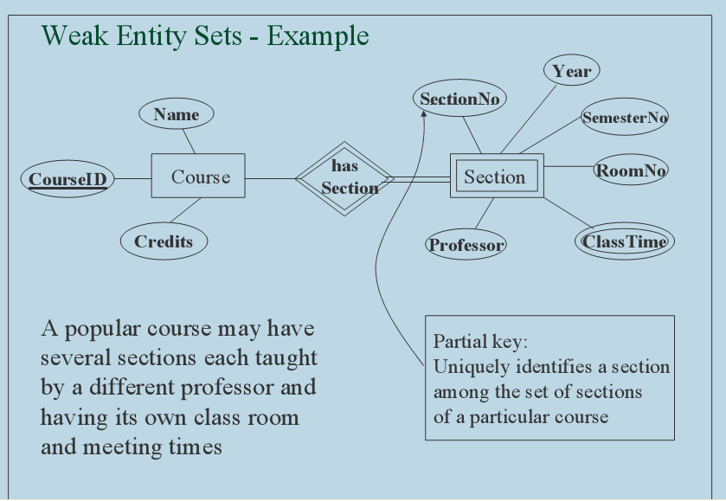

Weak Entity

Slide 74
Example 1
A publishing company produces scientific books on various subjects. The books are written by authors who specialize in one particular subject. The company employs editors who, not necessarily being specialists in a particular area, each take sole responsibility for editing one or more publications.
A publication covers essentially one of the specialist subjects and is normally written by a single author. When writing a particular book, each author works with on editor, but may submit another work for publication to be supervised by other editors. To improve their competitiveness, the company tries to employ a variety of authors, more than one author being a specialist in a particular subject.

Slide 75
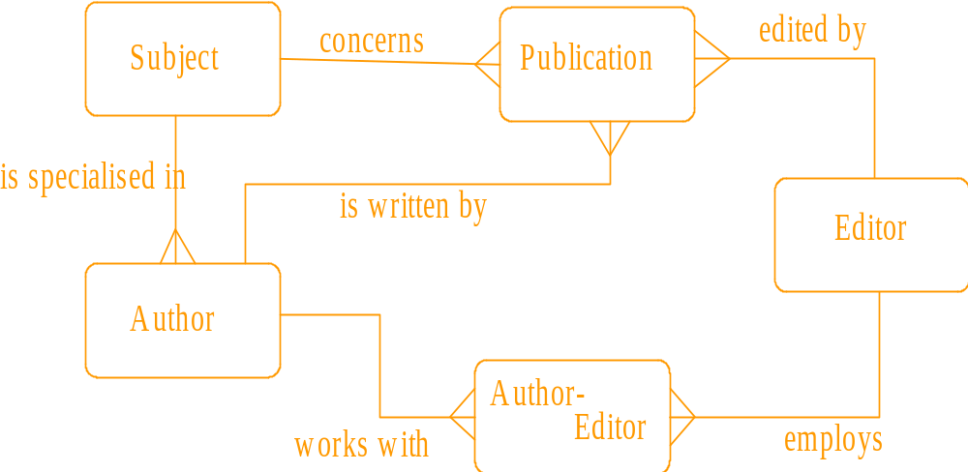
Example 1 - answer

Slide 76
Example 2
A General Hospital consists of a number of specialized wards (such as Maternity, Paediatry, Oncology, etc). Each ward hosts a number of patients, who were admitted on the recommendation of their own GP and confirmed by a consultant employed by the Hospital. On admission, the personal details of every patient are recorded. A separate register is to be held to store the information of the tests undertaken and the results of a prescribed treatment.
A number of tests may be conducted for each patient. Each patient is assigned to one leading consultant but may be examined by another doctor, if required. Doctors are specialists in some branch of medicine and may be leading consultants for a number of patients, not necessarily from the same ward.

Slide 77
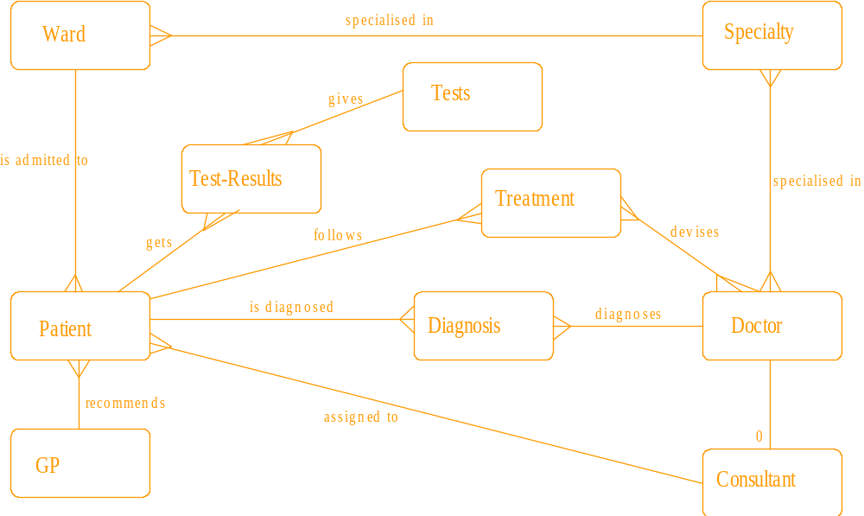
Example 2 – Full answer

